Slide 1

STOCK MARKET DATA PIPELINE
REVIEW – 4
Batch 17 - Section 4
Team members
Roll No Name
2420030415 G.Rithwik
2420030592 J.Kumudavalli
2420090113 T.Ram Tejaswi Reddy
Under the guidance of
Dr. Nalla Shirisha
Associate Professor
Department of Computer Science and Engineering
Koneru Lakshmaiah Education Foundation
(Deemed to be University estd. u/s. 3 of the UGC Act, 1956)
Off-Campus: Bachupally-Gandimaisamma Road, Bowrampet, Hyderabad, Telangana - 500 043.
Phone No: 7815926816, www.klh.edu.in

Slide 2
Table of contents
ABSTRACT
INTRODUCTION
EXISTING SYSTEM
PROPOSED SYSTEM
OBJECTIVES
LITERATURE SURVEY
SOFTWARE REQUIREMENTS
HARDWARE REQUIREMENTS
FUNCTIONAL REQUIREMENTS
NON-FUNCTIONAL REQUIREMENTS
SYSTEM ARCHITECTURE
UML DIAGRAM
METHODOLOGY, SYSTEM DESIGN AND ARCHITECTURE
OUTPUT AND RESULTS

Slide 3
Abstract
The Stock Market Data Pipeline is designed to collect, process, and analyze stock market data in a structured and efficient manner. Stock market data such as opening price, closing price, highest price, lowest price, trading volume, and timestamps is collected from financial data sources or APIs. The pipeline cleans and preprocesses the collected data by handling missing, duplicate, inconsistent, or incorrect records and then transforms it into a suitable format for analysis. The processed data can be stored and analyzed to identify stock price movements, trends, trading patterns, and market behavior. Visualization techniques can be used to present the analyzed information through charts or dashboards, helping users understand market trends and make data-driven financial decisions.

Slide 4
Introduction
The stock market produces a large amount of data every day through buying and selling activities. This data includes open, high, low, close prices, trading volume, timestamps, and other market information.
Analyzing raw stock market data directly can be difficult because the data may contain missing values, duplicate records, incorrect formats, and inconsistencies.
A Stock Market Data Pipeline solves this problem by collecting market data and passing it through different processing stages. The pipeline cleans and transforms the raw data before storing it in a structured format.
The processed data can then be analyzed to identify market trends, price movements, volatility, and trading patterns.
Therefore, a stock market data pipeline helps make financial data organized, accessible, and easier to analyze.

Slide 5
LIMITATIONS OF EXISTING SYSTEM
Manual Data Collection – Stock data is often collected manually from different sources.
Poor Data Quality – Missing, duplicate, inconsistent, or incorrect records can remain.
Time-Consuming Processing – Cleaning and analyzing large amounts of data manually takes more time.
Limited Real-Time Monitoring – Traditional systems may not continuously process live market data.
Difficult Data Management – Data from multiple sources can be difficult to organize and maintain.
Slow Trend Analysis – Identifying price movements and trading patterns takes more effort.
Limited Visualization – Data may be presented as raw tables instead of interactive charts or dashboards.
Higher Risk of Human Errors – Manual calculations and data entry can lead to inaccurate results.

Slide 6
PROPOSED SYSTEM
The proposed system is an automated stock market data pipeline that converts raw market data into meaningful insights through multiple processing stages.
Pipeline:
Stock Market API / Historical Dataset
↓
Data Collection – Collect stock symbol, date, Open, High, Low, Close and Volume
↓
Data Cleaning – Handle missing, duplicate and inconsistent records
↓
Data Transformation – Calculate price changes, returns, moving averages and volume patterns
↓
Data Storage – Store processed data in SQL/database or file system
↓
Data Analysis – Analyze prices, volume, trends and market patterns
↓
Visualization – Generate charts and dashboards using Matplotlib/Plotly
↓
Market Insights – Provide understandable information about market movements
Technologies Used
Python – Pipeline development and processing
Pandas – Cleaning and transformation
NumPy – Numerical calculations
SQL/Database – Data storage
Matplotlib/Plotly – Visualization
Jupyter Notebook – Development and testing
Stock Market API – Historical/real-time data collection
Main advantage: It reduces manual effort, improves data quality, speeds up analysis, and makes market trends easier to understand.

Slide 7
Objectives
To collect historical and real-time stock market data from reliable data sources or APIs.
To clean and preprocess the collected data by handling missing, duplicate, and inconsistent records.
To transform raw stock market data into a structured format suitable for analysis.
To analyze stock prices, trading volume, market trends, and price movements.
To identify useful patterns and trends from historical stock market data.
To visualize stock market information using charts and dashboards.
To support efficient and data-driven financial market analysis.

Slide 8
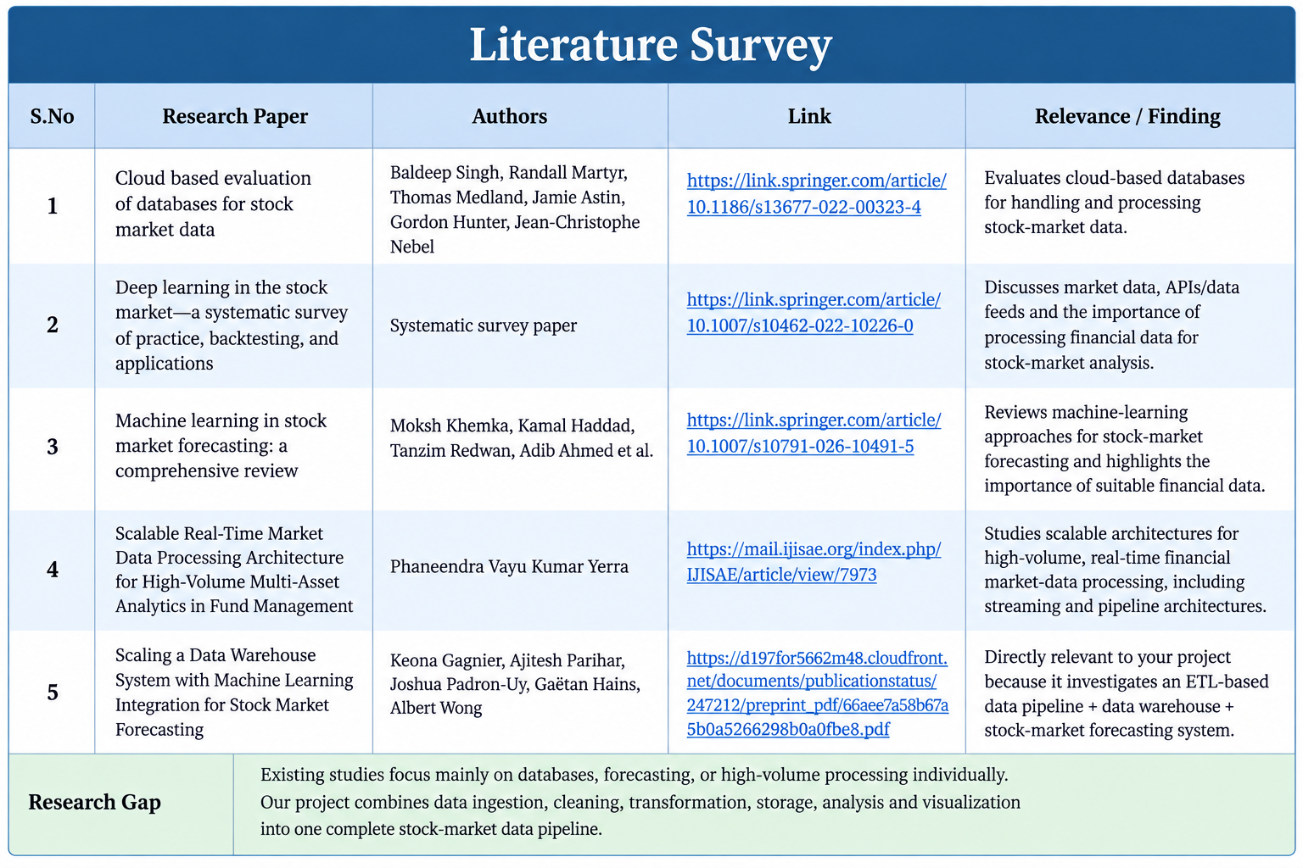

Slide 9
SOFTWARE REQUIREMENTS
Operating System: Windows / Linux
Programming Language: Python
Libraries: Pandas, NumPy
Database: SQL
Visualization: Matplotlib / Plotly
Development Environment: Jupyter Notebook
Data Source: Stock Market API / Historical Dataset
Dashboard: Python-based visualization/dashboard

Slide 10
HARDWARE REQUIREMENTS
Processor: Intel Core i3 or equivalent
RAM: 4 GB minimum
Storage: 10 GB available space
System: Desktop/Laptop
Internet: Required for Stock Market API data collection
Display: Standard monitor
Processor: Core i3 | RAM: 4 GB | Storage: 10 GB | Internet: Required | Device: Laptop/Desktop

Slide 11
FUNCTIONAL REQUIREMENTS
Data Collection – Collect historical and real-time stock market data from APIs or datasets.
Data Cleaning – Handle missing, duplicate, inconsistent, and incorrect records.
Data Transformation – Convert raw data into a structured format and calculate useful indicators.
Data Storage – Store processed stock data in a database or file system.
Data Analysis – Analyze stock prices, trading volume, trends, and market patterns.
Data Visualization – Generate charts and dashboards to display market information.
Market Insights – Provide meaningful insights about stock movements and trends.
Real-Time Monitoring – Support continuous monitoring when connected to a live data source.

Slide 12
NON FUNCTIONAL REQUIREMENTS
Performance – Process large amounts of stock data efficiently.
Scalability – Handle increasing amounts of market data.
Reliability – Provide consistent and accurate processing.
Security – Protect stored and processed financial data.
Maintainability – Keep the pipeline modular and easy to update.
Usability – Present results through clear charts and dashboards.
Availability – Support continuous data processing when live data is available.
Data Quality – Maintain clean, consistent, and accurate data.

Slide 13
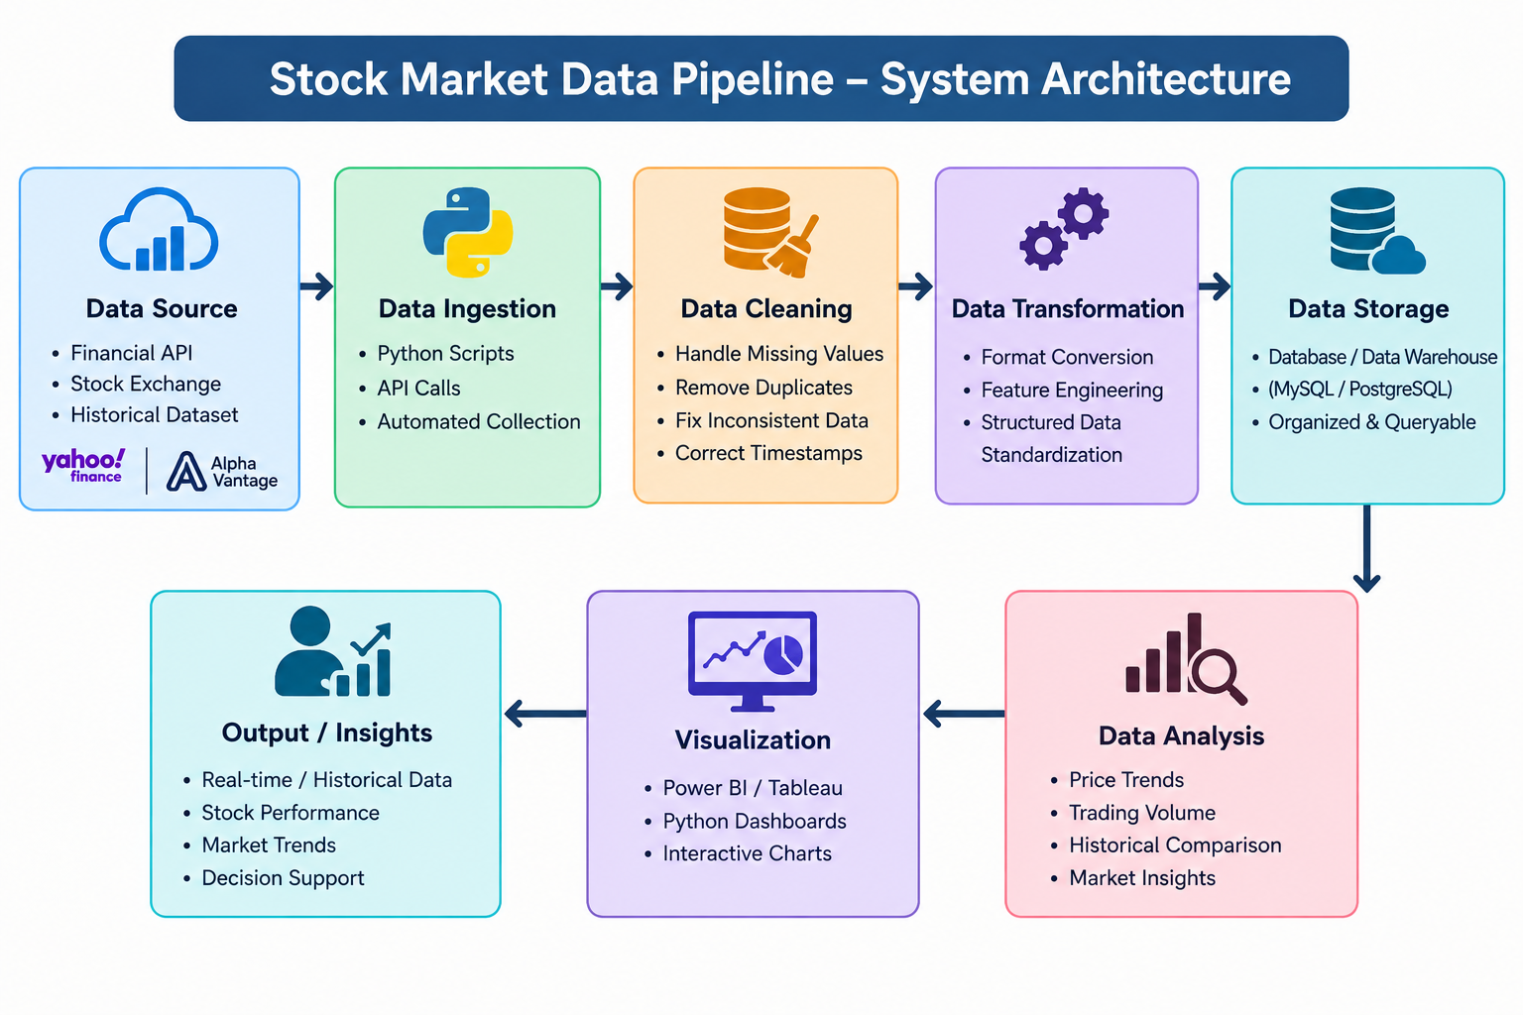
System Architecture

Slide 14
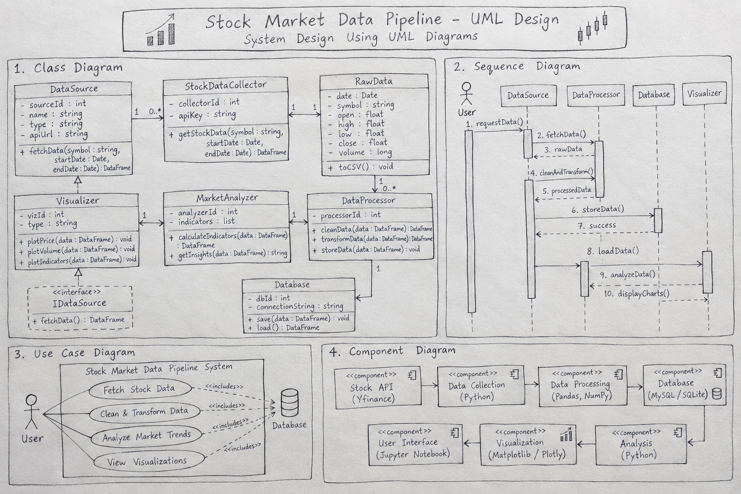

Slide 15
Methodology, System Design and Architecture
The Stock Market Data Pipeline begins by collecting stock market data from reliable data sources such as financial APIs or historical datasets. The collected data generally contains information such as stock symbol, date, opening price, highest price, lowest price, closing price, and trading volume. This raw data is then passed through preprocessing, where missing, duplicate, and inconsistent records are identified and handled. The data is converted into a consistent and structured format so that it can be used effectively for further analysis.
After preprocessing, the cleaned data is transformed into a suitable format for analysis. Different features such as price changes, returns, moving averages, and trading-volume patterns can be derived from the available data. The transformed data is then stored in a structured database or file system for efficient access. Finally, the processed stock market data is analyzed to identify price movements, trends, and market patterns, and the results are presented through visualizations and dashboards.

Slide 16
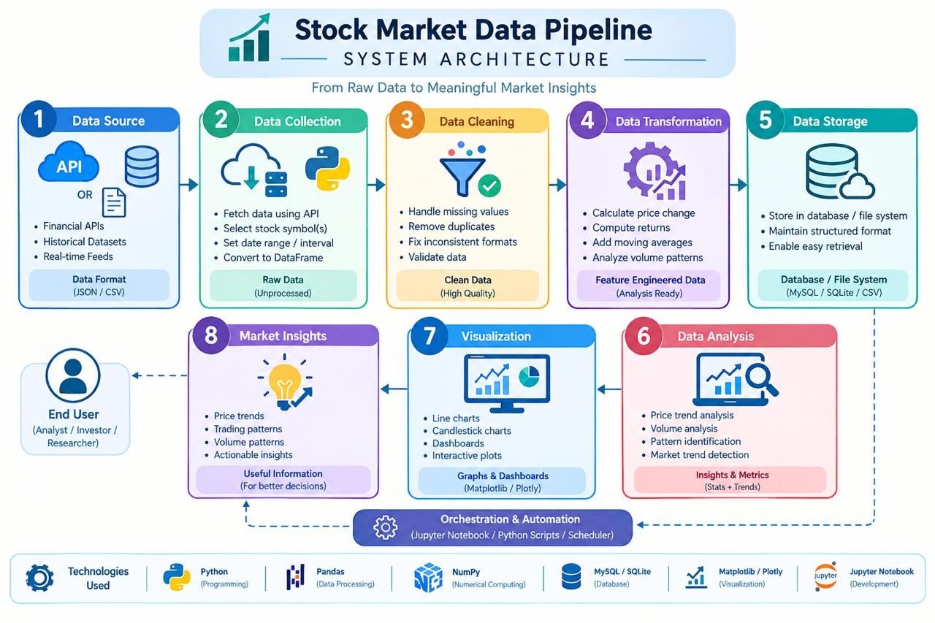
System Architecture

Slide 17
Use of Modern Tools and Technologies
Technologies Used
Python
Used for data collection, processing, analysis, and pipeline development.
Pandas
Used for data cleaning, manipulation, transformation, and analysis.
NumPy
Used for numerical operations and financial calculations.
SQL / Database
Used to store and retrieve processed stock market data.
Matplotlib / Plotly
Used to visualize stock prices, trading volume, and market trends.
Jupyter Notebook
Used for development, experimentation, and testing.
Stock Market API
Used to obtain historical or real-time market data.

Slide 18
Benefits
Automated Data Processing – Reduces manual effort in collecting and processing stock market data.
Improved Data Quality – Handles missing, duplicate, and inconsistent data.
Faster Analysis – Processes large amounts of stock market data efficiently.
Better Trend Identification – Helps identify price movements, market trends, and trading patterns.
Easy Visualization – Presents stock information through charts and dashboards.
Real-Time Monitoring – Can support continuous monitoring of market data when connected to live data sources.
Data-Driven Decisions – Provides useful insights for financial and market analysis.

Slide 19
Implementation, Coding Quality and Functionality
Implementation
Develop the stock market data pipeline.
Collect stock market data from an API/data source.
Store raw market data.
Clean missing and inconsistent records.
Transform the collected data.
Calculate useful market indicators.
Analyze stock price and volume trends.
Generate charts and visualizations.
Display processed information through a dashboard.

Slide 20
Coding Quality
Simple and structured implementation.
Modular pipeline components.
Clear and understandable Python code.
Proper data preprocessing.
Efficient data handling.
Error handling for missing or invalid data.
Reusable functions for different stocks.
Maintainable and scalable implementation.

Slide 21
Functionality
The Stock Market Data Pipeline collects and processes financial market data and converts raw information into a structured dataset suitable for analysis. It performs data cleaning and transformation before storing the processed information. The system can analyze stock prices and trading volumes to identify important trends and patterns. The final results are presented using visualizations or a dashboard, allowing users to easily understand stock market movements and obtain useful insights.

Slide 22
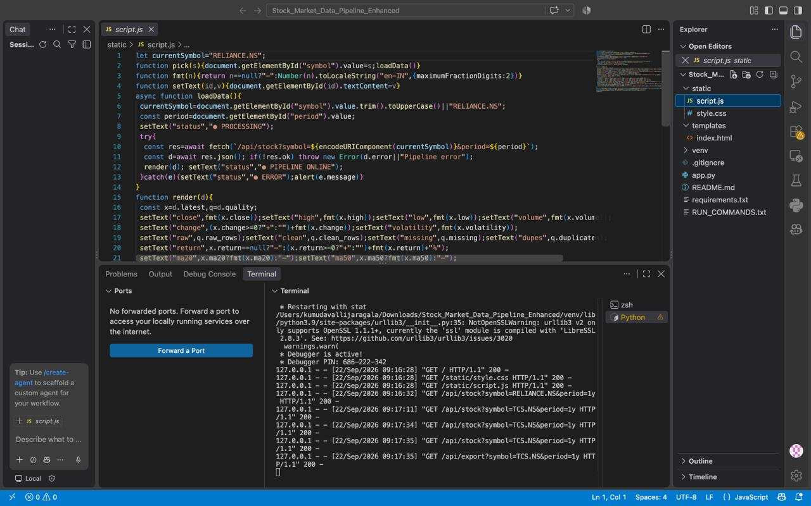

Slide 23
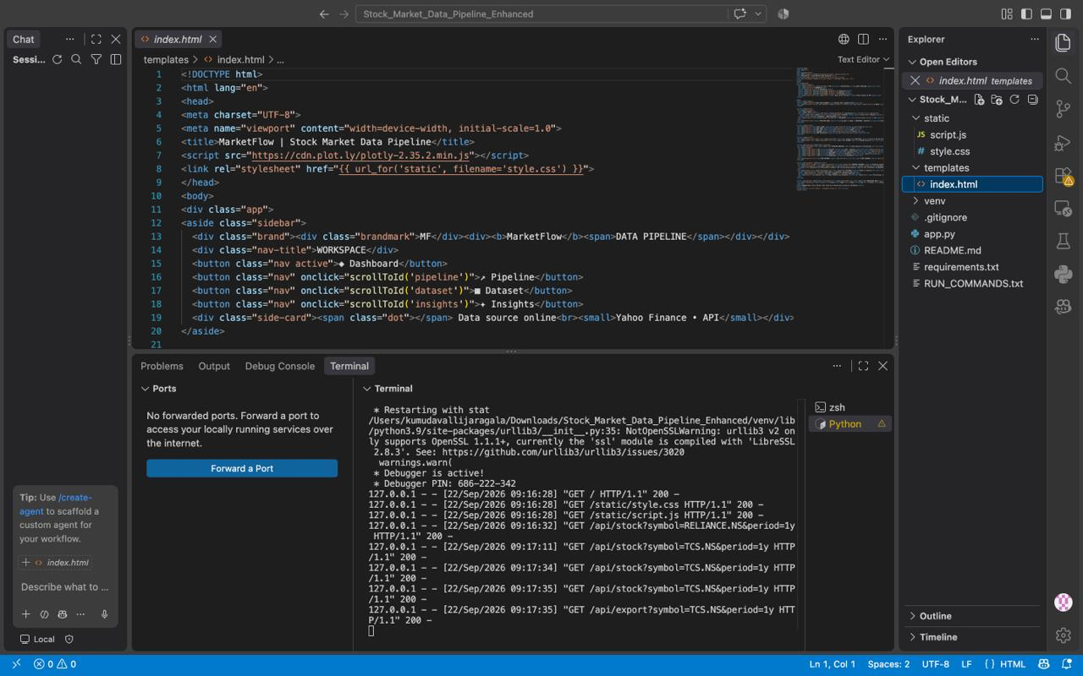

Slide 24
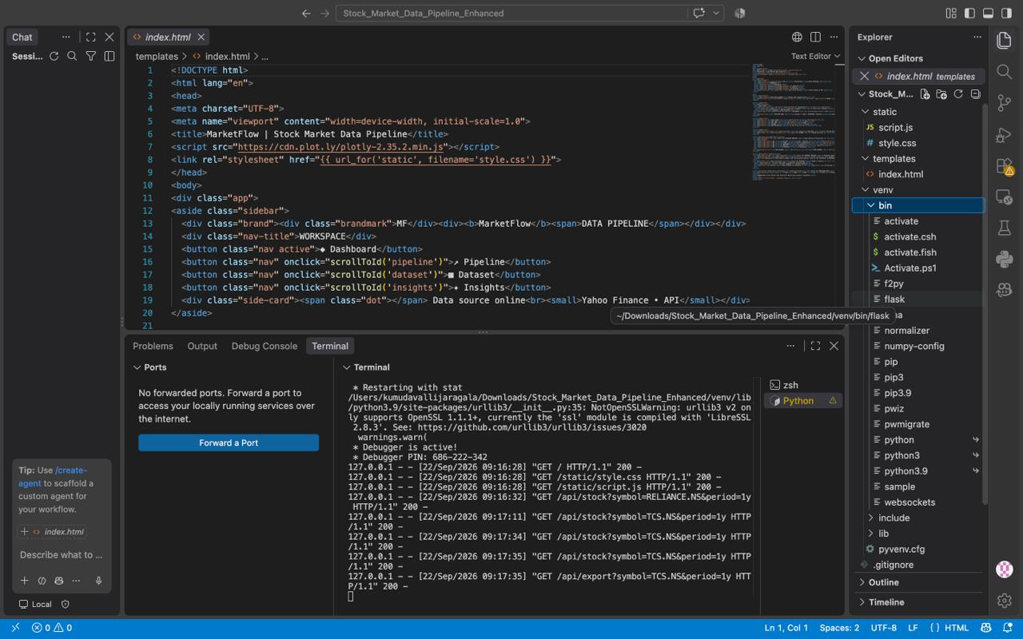

Slide 25
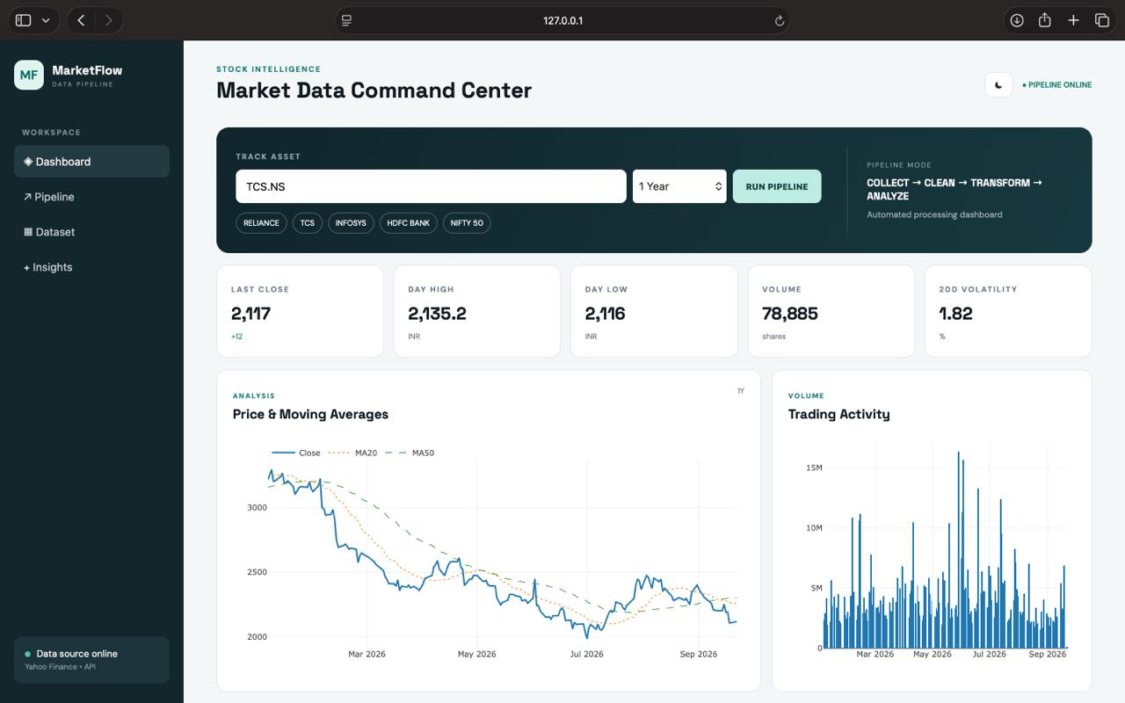
OUTPUT AND RESULTS

Slide 26
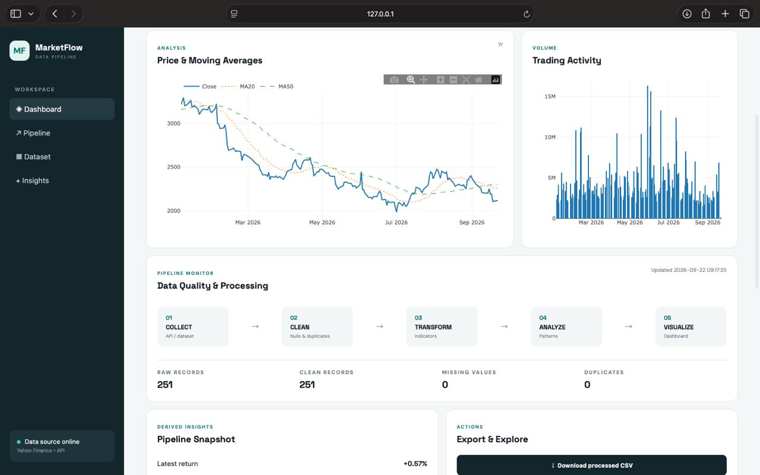

Slide 27
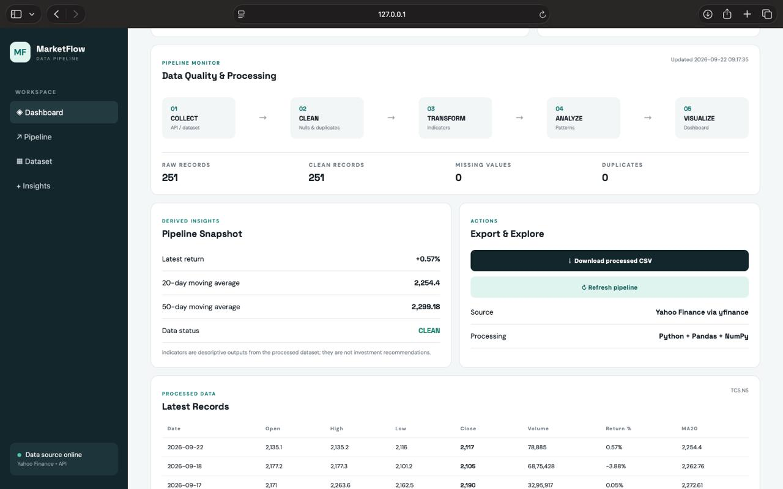

Slide 28
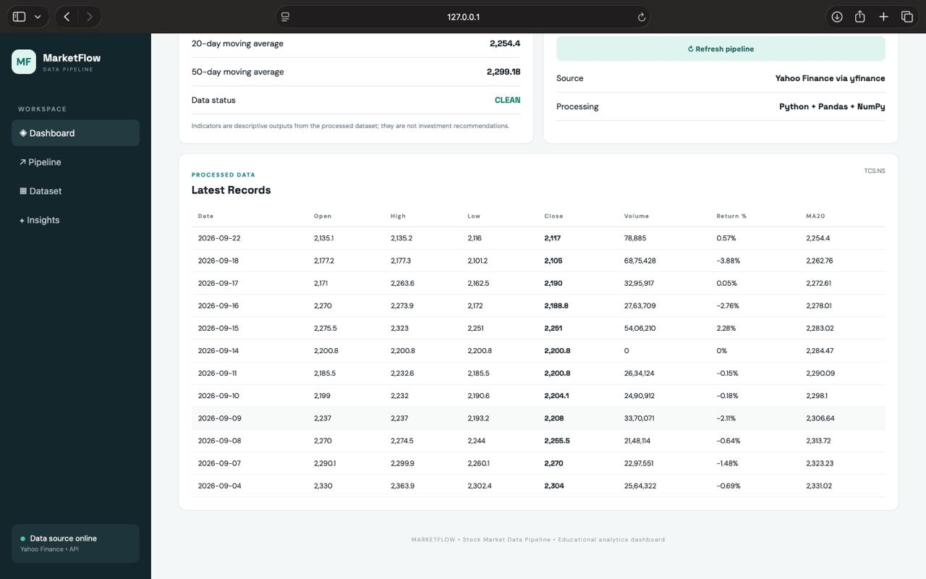

Slide 29
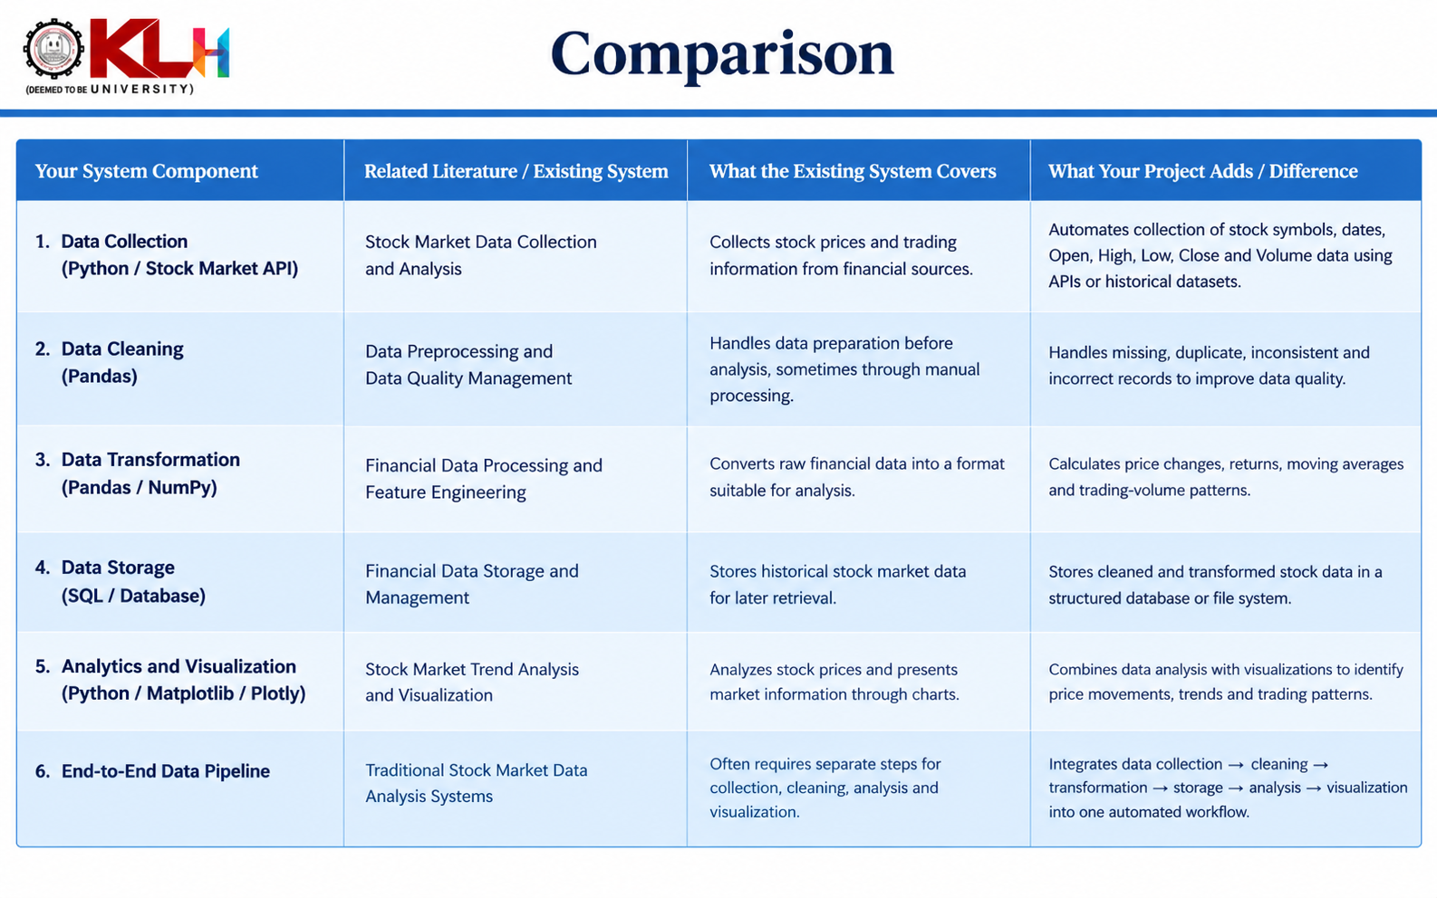

Slide 30
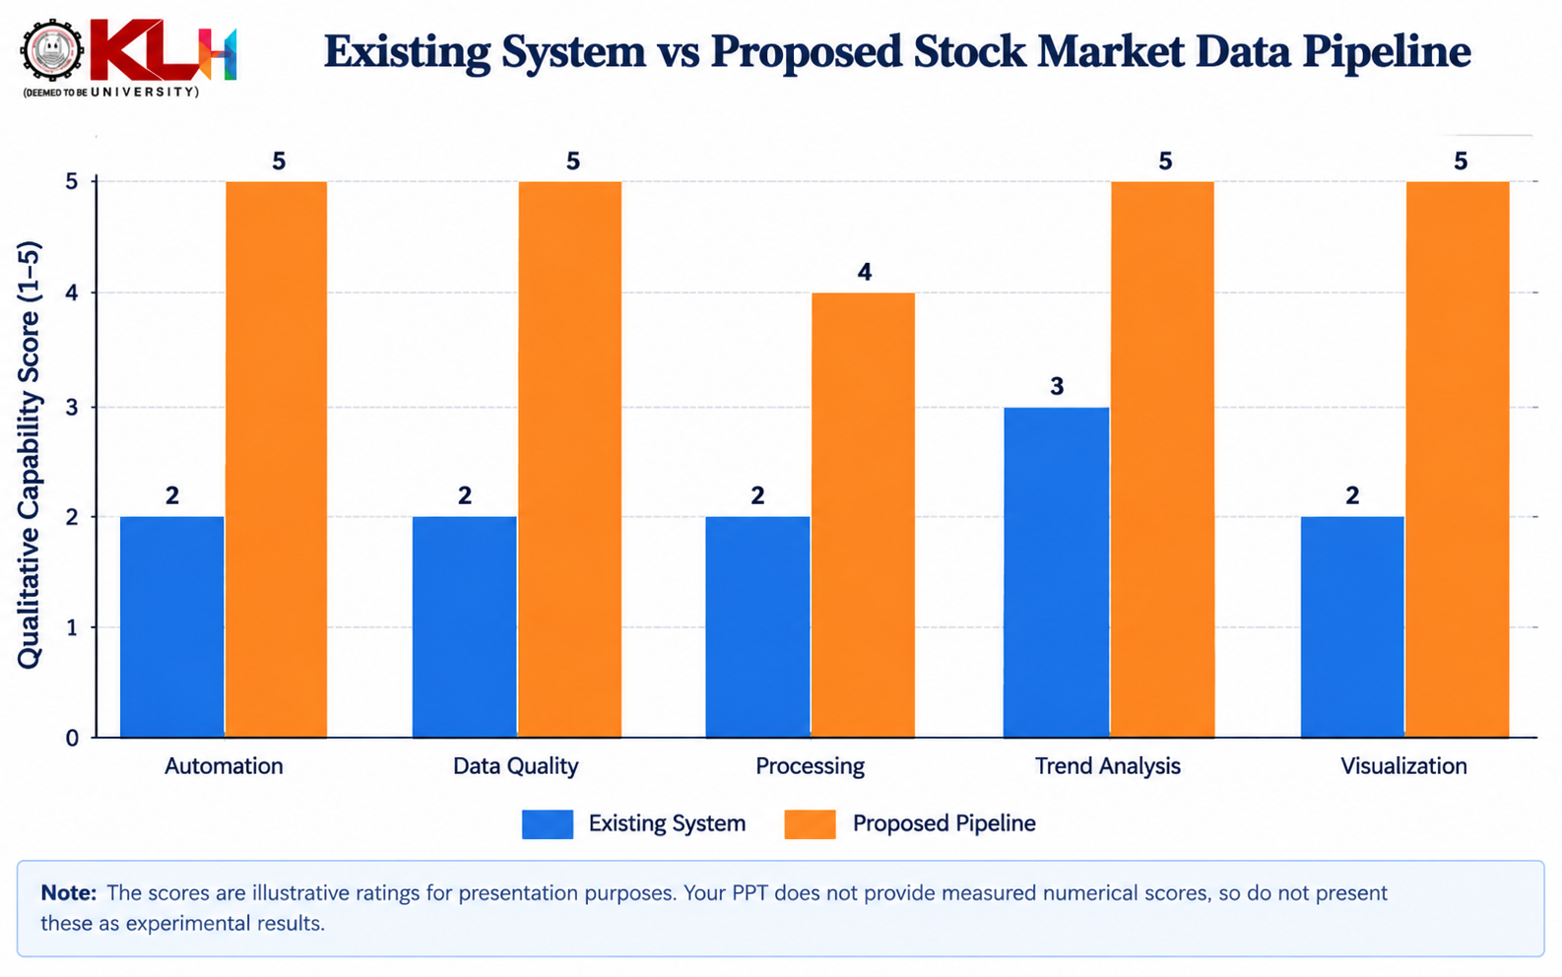

Slide 31
CONCLUSION
The Stock Market Data Pipeline provides an automated approach to collecting and processing stock market data.
It improves data quality by handling missing, duplicate, inconsistent, and incorrect records.
Python, Pandas, and NumPy support efficient data cleaning, transformation, and numerical analysis.
The system helps analyze stock prices, trading volume, price movements, and market trends.
Data visualization using Matplotlib or Plotly makes market information easier to understand.
The integrated pipeline reduces manual effort and supports efficient, data-driven financial analysis.
The system can be extended to support real-time market monitoring and advanced analytics.

Slide 32
REFERENCES
andas Documentation. Data manipulation, cleaning, and analysis. https://pandas.pydata.org/docs/
NumPy Documentation. Numerical computing with Python. https://numpy.org/doc/stable/
Matplotlib Documentation. Data visualization using Python. https://matplotlib.org/stable/
yfinance Documentation. Downloading historical stock market data. https://ranaroussi.github.io/yfinance/
Python Documentation. Python programming language and standard library. https://docs.python.org/3/
Project dataset and stock market API documentation used for data collection and analysis.

Slide 33
THANKYOU

